Slide 1

NITI CREATIONS

Slide 2
NITI CREATIONS IS INVOLVED IN AUDIO AND VIDEO PRODUCTIONS AND CATERS TO ALL THE REQUIREMENT OF THE CLIENTS PERTAINING TO THEIR PROJECT.
WE PROVIDE QUALITY WORK AND HELP IN FULFILLING THE DREAMS OF THE CLIENT BY EXECUTING THEIR PROJECT.

Slide 3
About Us
NITI CREATIONS WHICH CAME INTO ACTION IN 2011 IS AN AUDIO VIDEO PRODUCTION HOUSE WHOSE FOCUS IS ON QUALITY WORK AT A REASONABLE COST.
WE HAVE ALLIANCES WITH SOME OF THE LEADING CLIENTELE AND THUS ARE ABLE TO EXECUTE PROJECTS KEEPING AUDIENCE INTEREST IN MIND.
OUR TEAM CONSISTS OF EXPERIENCED DIRECTORS, WRITERS AND OTHER CREATIVE AND TECHNICAL PROFESSIONALS. WE OFFER THE REQUIRED SERVICES TO THE CLIENT WITHOUT COMPROMISING ON PRODUCTION VALUES.

Slide 4
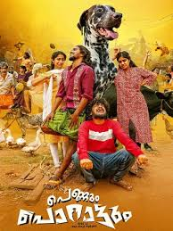
Our Projects-Audio Production (Film)
‘PERRUM PORATTUM’ film dubbed from Malayalam to Hindi for Netflix.

Slide 5
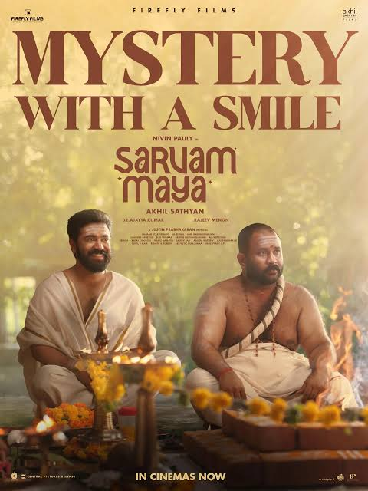
Our Projects-Audio Production (Film)
‘SARVAM MAYA’ film dubbed from Malayalam to Hindi for Hotstar.

Slide 6
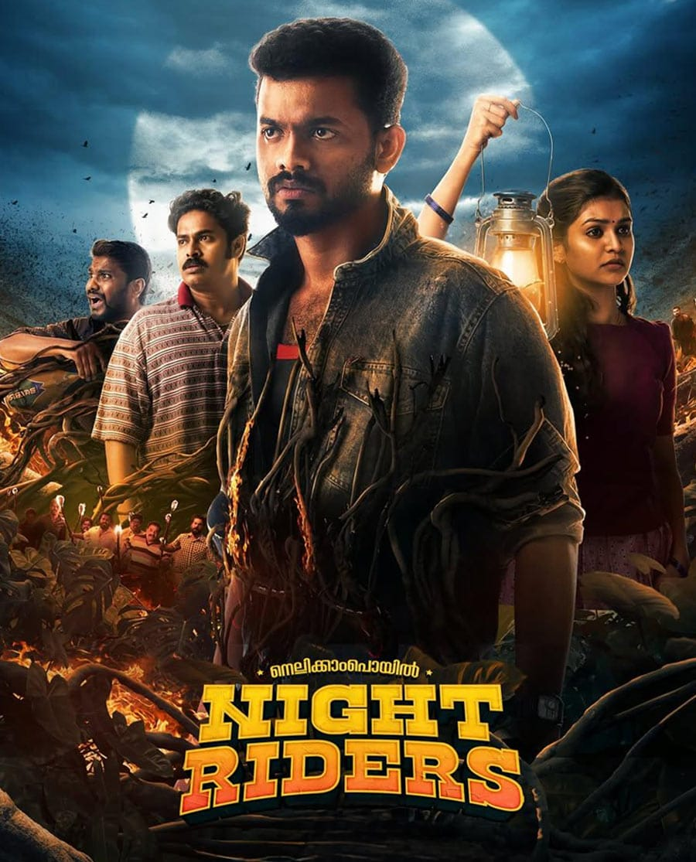
Our Projects-Audio Production (Film)
‘NELLIKAMPOYIL NIGHT RIDERS’ film dubbed from Malayalam to Hindi for Hotstar.

Slide 7
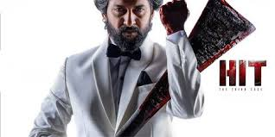
Our Projects-Audio Production (Film)
‘HIT THE THIRD CASE’ film dubbed from Telugu to Hindi for Theatrical release and Netflix.

Slide 8

Our Projects-Audio Production (Film)
‘ALAPUZZHA GYMKHANA’ film dubbed from Malayalam to Hindi for Sony Liv.

Slide 9

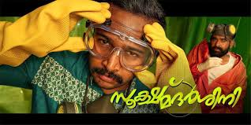
Our Projects-Audio Production (Film)
‘SOOKSHMADARSHINI’ film dubbed from Malayalam to Hindi for Hotstar and from Malayalam to English.

Slide 10
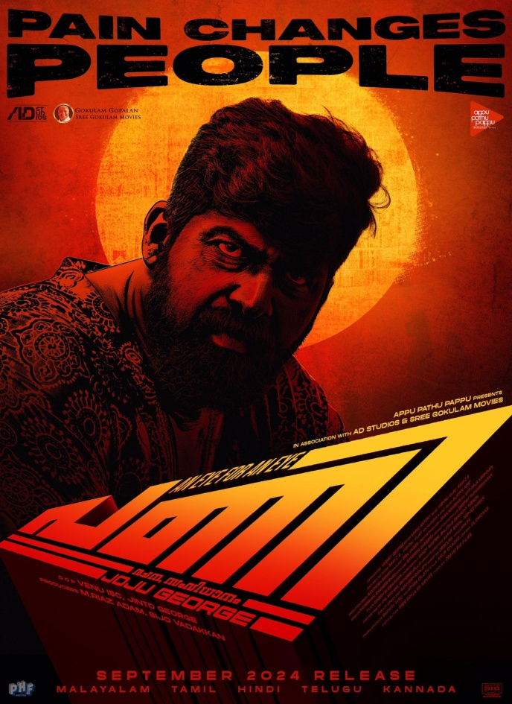
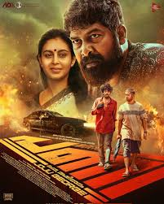
Our Projects-Audio Production (Film)
‘PANI’ film dubbed from Malayalam to Hindi for Sony Liv.

Slide 11

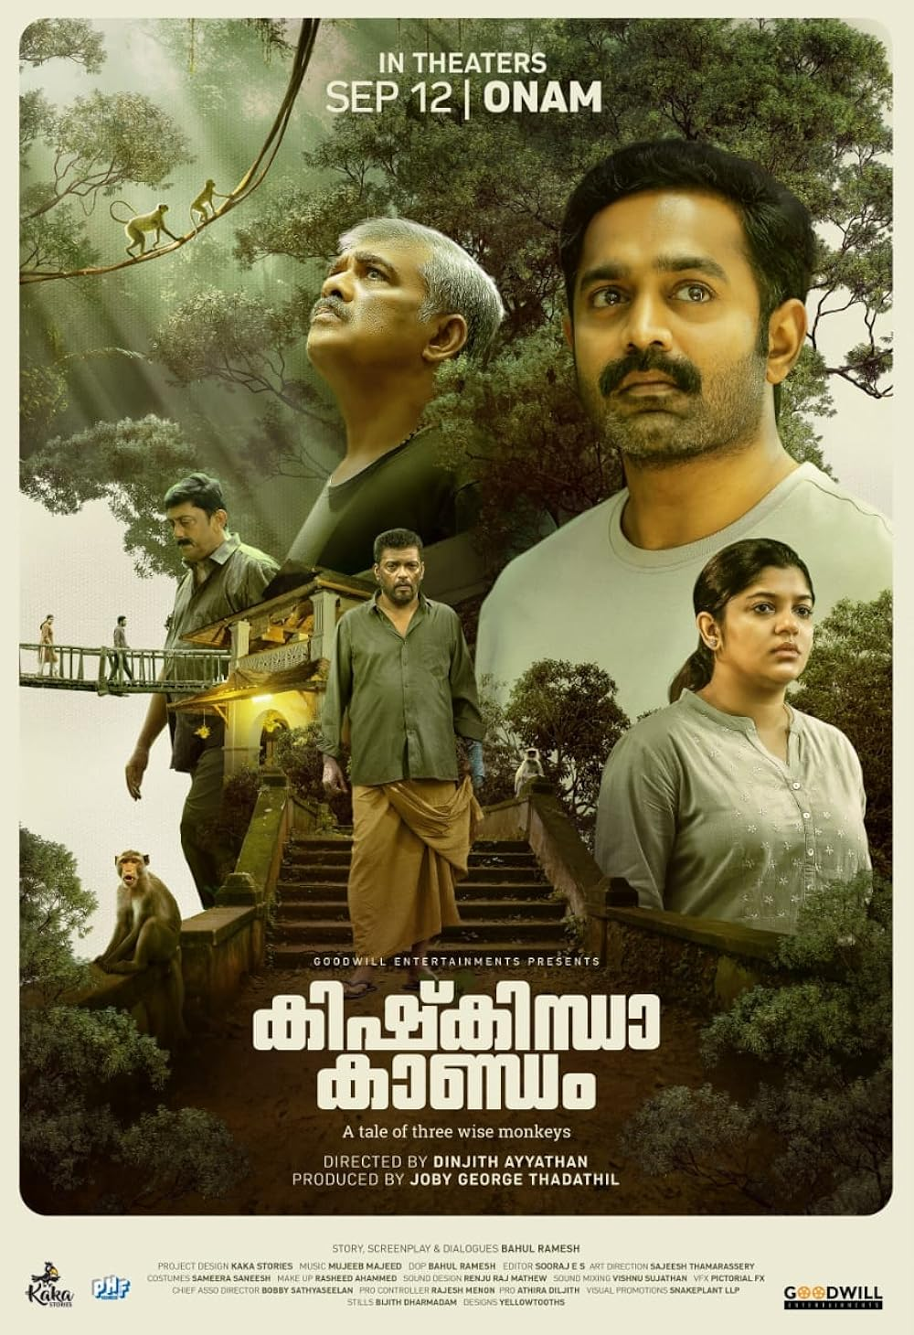
Our Projects-Audio Production (Film)
‘KISHKINDHA KAANDAM’ film dubbed from Malayalam to Hindi for HOTSTAR

Slide 12
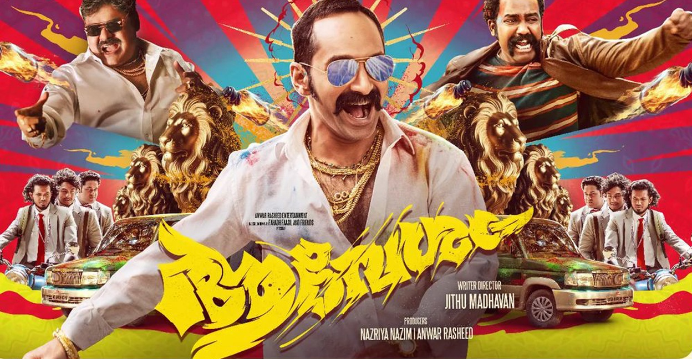
Our Projects-Audio Production (Film)
‘AAVESHAM’ film dubbed from Malayalam to Hindi for HOTSTAR

Slide 13
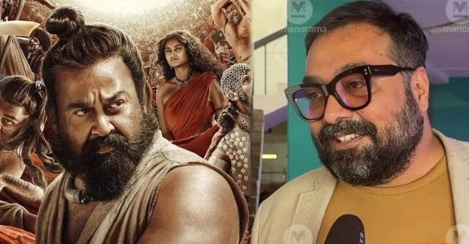
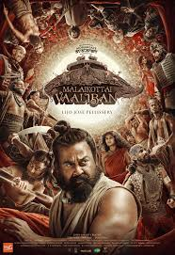
Our Projects-Audio Production (Film)
‘MALAIKOTTAI VALLIBAN’ film dubbed from Malayalam to Hindi for HOTSTAR. Main lead Mohanlaal’s voice dubbed in Hindi by Anurag Kashyap.

Slide 14

Our Projects-Audio Production (Film)
‘LOVE DALE’ film dubbed from Malayalam to Hindi, Bengali, Bhojpuri and English.

Slide 15

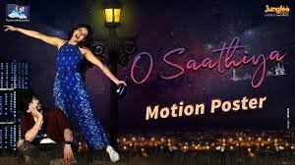
Our Projects-Audio Production (Film)
‘O SAATHIYA’ film dubbed from Telugu to Hindi & Bengali for AMAZON PRIME.

Slide 16

Our Projects-Audio Production (Film)
‘MADHURA MANOHARA MOHAM’ film dubbed from Malayalam to Hindi.

Slide 17

Our Projects-Audio Production (Film)
‘NEYMAR’ film dubbed from Malayalam to Hindi for Hotstar.

Slide 18
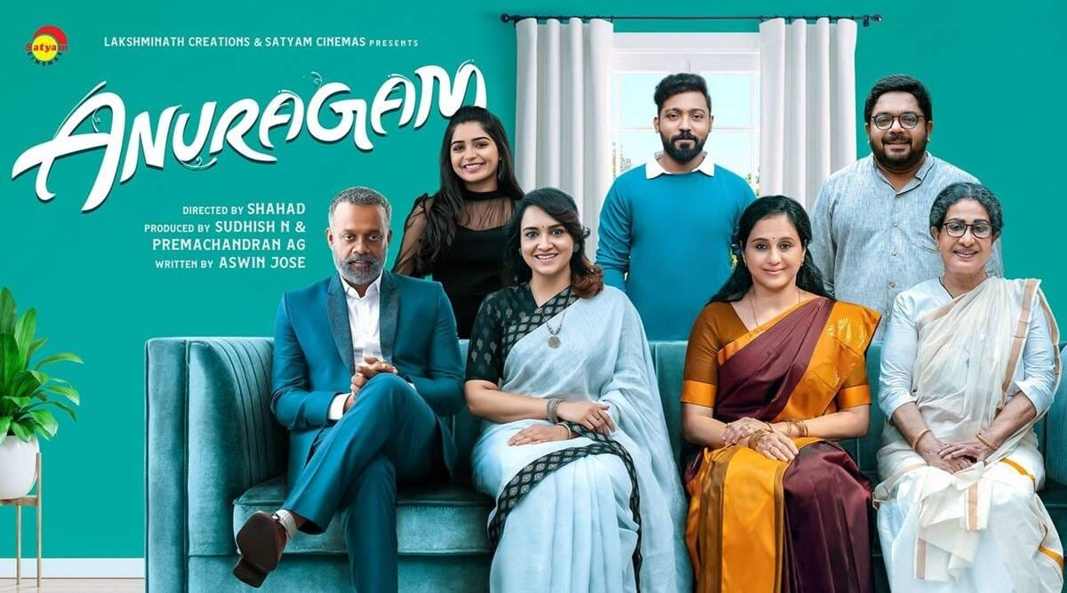
Our Projects-Audio Production (Film)
‘ANURAGAM’ film dubbed from Malayalam to Hindi.

Slide 19


Our Projects-Audio Production (Film)
‘JANAKI JAANE’ film dubbed from Malayalam to Hindi for HOTSTAR.

Slide 20
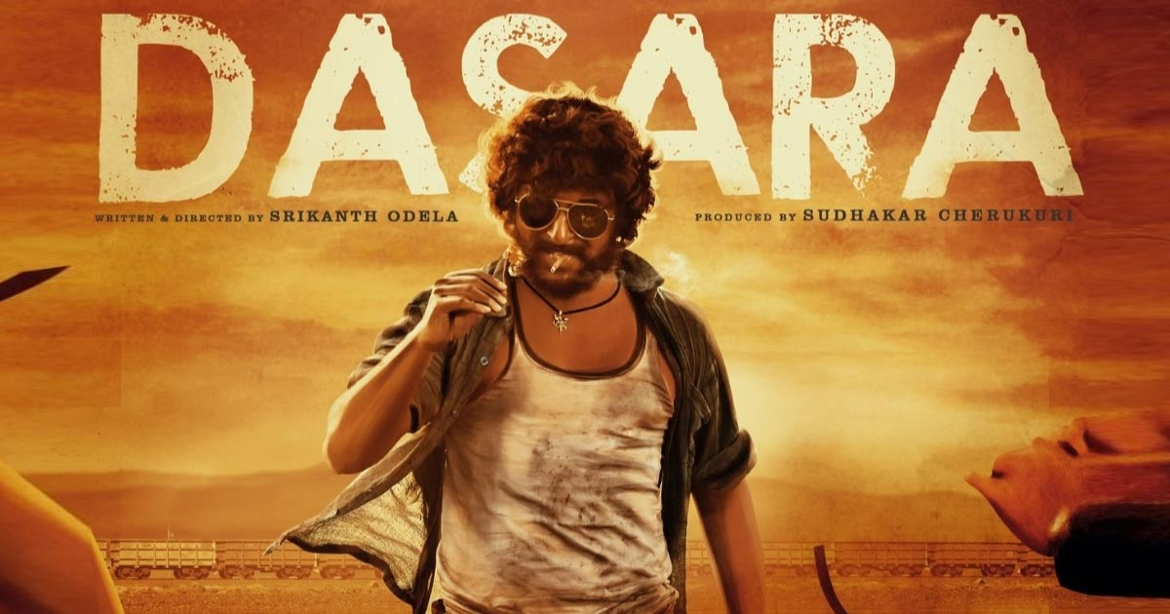
Our Projects-Audio Production (Film)
‘DASARA’ film dubbed from Telugu to Hindi ran in theatres and currently on NETFLIX.

Slide 21
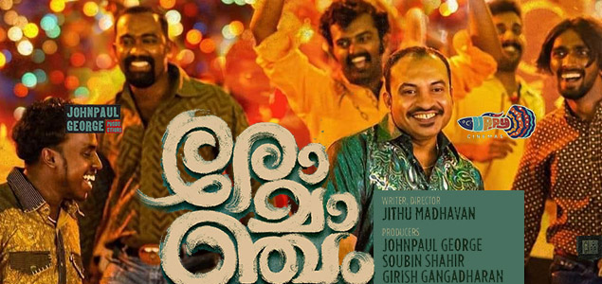
Our Projects-Audio Production (Film)
‘Romancham’ film dubbed from Malayalam to Hindi, available on HOTSTAR

Slide 22
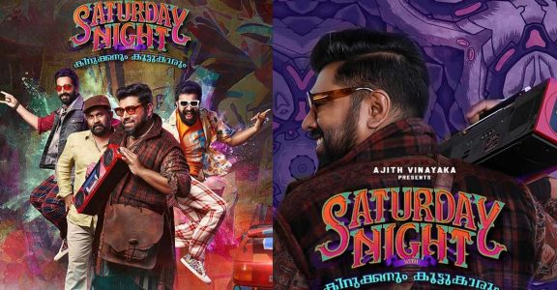
Our Projects-Audio Production (Film)
‘Saturday Night’ film dubbed from Malayalam to Hindi, available on HOTSTAR

Slide 23
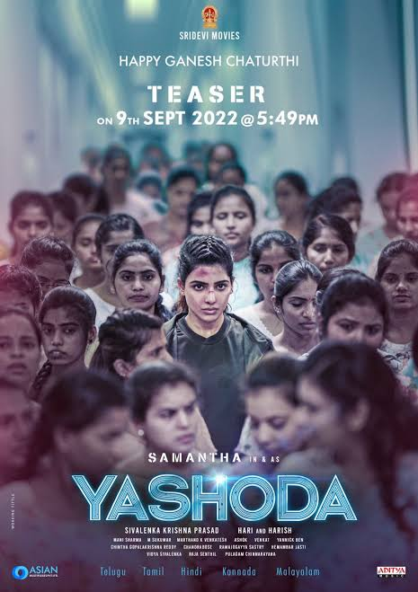

Our Projects-Audio Production (Film)
‘Yashoda’ film dubbed from Telugu to Hindi (Theatrical) available on AMAZON PRIME

Slide 24

Our Projects-Audio Production
(Film)
‘Palthu Janwar’ film dubbed from Malayalam to Hindi, available on ‘Hotstar’

Slide 25


Our Projects-Audio Production
(Film)
‘Ya Rab’ film dubbed from Hindi to English, French and Arabic

Slide 26
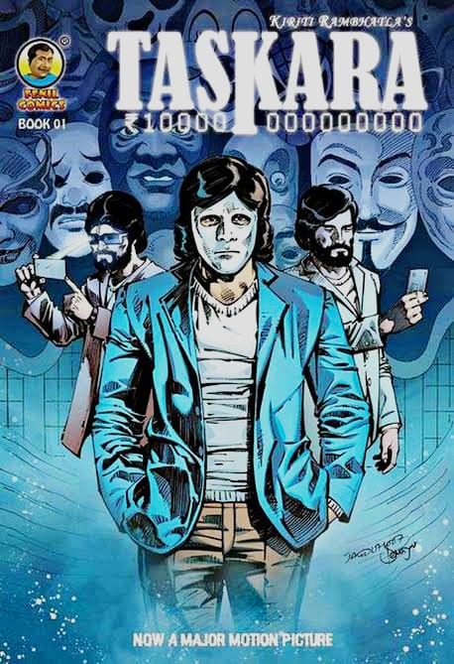
Our Projects-Audio Production
(Film)
‘Taskara’ film dubbed from Telugu to Hindi

Slide 27
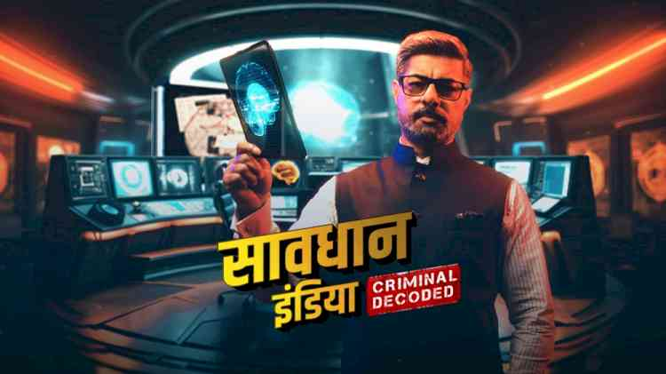
Our Projects-Audio Production
(Series)
‘Saavdhan India’ series dubbed from Hindi to Hindi

Slide 28

Our Projects-Audio Production
(Ad film)
Ad for Aspee dubbed from Hindi to Tamil, Telugu, Malayalam, Kannada, Assamese and Bengali.
https://youtu.be/xr6S5sXbeWs -(Malayalam)
https://youtu.be/csRTjEvmZRA - (Bengali)
https://youtu.be/8jMO6m0Ss60 -(Telugu)
https://youtu.be/G3K5XQcX3qc- (Assamese)

Slide 29

Our Projects-Audio Production (Ad film)
Ad for Goldmedal dubbed from Hindi to Marathi, Tamil, Telugu, Malayalam and Punjabi
https://youtu.be/1NuUo15tbB8 -(Marathi)
https://youtu.be/jbBEMaI8iUM -(Tamil)
https://youtu.be/FAH256fIYEQ - (Punjabi)
https://youtu.be/tEE-7IWCYbQ - (Telugu)

Slide 30

Our Projects-Audio Production (Ad film)
Ad for Yaari dubbed in Hindi, English and Bengali.
English main AV- https://youtu.be/S725jeb62jU
https://youtu.be/QE2IkyzsvZc (Hindi)
https://youtu.be/B43Hx48phUc (Bengali)
https://youtube.com/playlist?list=PLGA9zQTRSpL34w27b2vO9O61klfhhj2Gz (all english)

Slide 31
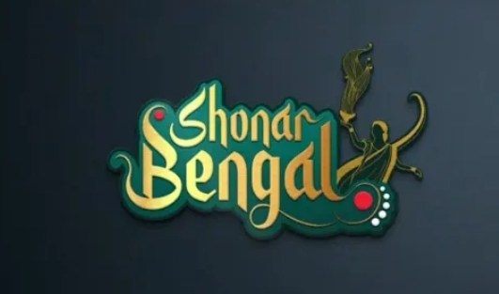
Our Projects-Audio Production(Web series-non fiction)
‘Shonar Bengal’- Non fiction web series dubbed from Hindi to Bengali and Bengali to Hindi for Zee Zest.
https://youtube.com/playlist?list=PLkPhKy_ozTbPE2n6YXrJ3ASsYGoSfdlH0

Slide 32

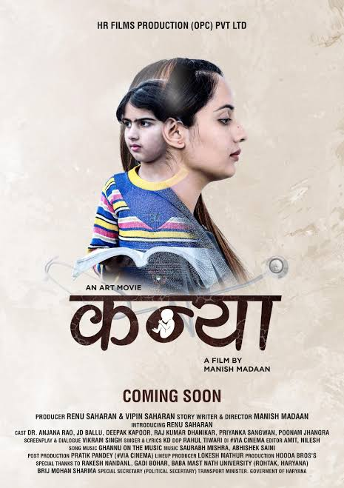
Our Projects-Audio Production
(Short Film)
Got a short film ‘Kanya’ translated and dubbed from Haryanvi to Hindi, English, Gujarati, Punjabi, Marathi, Bengali (7 languages)

Slide 33

Our Projects-Audio Production
Got 22 Franklin Templeton videos dubbed in English, Hindi, Bengali, Tamil and Gujarati
https://youtube.com/playlist?list=PLpDLpRd877mRvP2fuzG7Bby1cwuLQ6i3W – English
https://youtube.com/playlist?list=PLpDLpRd877mTv-UDGtQrlub2262HXuPFL – Bengali
https://youtube.com/playlist?list=PLpDLpRd877mQK6oddkl924mmDKQOc9rvb –Tamil
https://youtube.com/playlist?list=PLpDLpRd877mR5eGKJ9WaC5H-RkTfdnWas – Hindi
https://youtube.com/playlist?list=PLpDLpRd877mRc85gEKSZsIWs9yAFU5G5Z - Gujarati

Slide 34

Our Projects-Audio Production (Series)
Producer for History Channel since 1 ½ years and have got series like “ Scammed”, ”Heavy Haulers”, “101 Gadgets that changed the world”, “Galleons of Spice”, ”India on Four wheels”, “Brave New World”, “Around The World in 80 Ways”, “Black Ops”, “Marked”, “Mega Modern Marvels” etc. dubbed from English to Hindi, Bengali and Marathi.(hired and coordinated with the studios, translators, artists, sound and mixing engineers, dubbing directors, designed the way a dubbing should be done, co-ordinated with the channel for all languages) ... ”Scammed” was dubbed in Gujarati also.

Slide 35

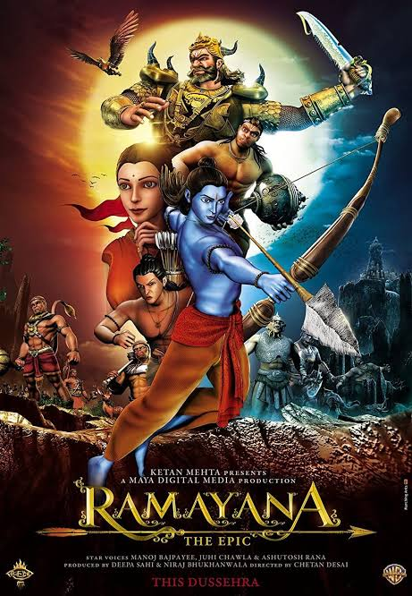
Our Projects-Audio Production (Animated film)
Co-ordinated the artists for a full fledged theatrical release animation Hindi feature film called “Ramayan” by Maya Entertainment.
https://youtu.be/Ven2W085g1k - Film Link

Slide 36
Our Projects-Audio Production
(Other Work)
128 files of ‘Base Videos’ written and dubbed in Hindi for Embibe. (Educational project)
Got Sony Liv projects like ‘Cubicles’(webseries seasons 2,3,4), ‘Gullak’ (web series-season 1,3,4),’Dr. Arora’(web series),’Faadu’(web series)‘Your Honour’(web series season 1&2), ‘Kadak’(film), ‘Bhonsle’(film), ‘Avrodh’, ‘Ram Singh Charlie’(Film),’Undekhi’(web series season 1,2,3), ‘Shrikant Bashir’(web series), Maharani, Kathmandu Connection, ‘Family Aajkal’ (season1) translated and dubbed from Hindi to Bengali under Aradhana Films.
‘Hillsong- Brian Houston’ series of 30 minutes translated, Qced and dubbed from English to Hindi for Sony channel for 3 years.
Got “Speak English Fatafat” dubbed in English (A whole book)

Slide 37
Our Projects-Audio Production(Other work)
Got commercial ads like ‘Clocip Powder’ dubbed in Hindi and of ‘Itel Ultra Dialer’ (90 seconds) dubbed from Hindi to Bengali and Malayalam. (includes hiring of translators for translations from Hindi to Bengali and Malayalam, choosing, providing and deciding the artists who will voice for the given characters, hiring studios and dub and mixing engineers, language directors dubbing direction and languages direction and premixing the audio files in respective languages..)
Got an international project of ‘Breast Cancer Care’ dubbed from English to Hindi, Urdu, Bengali and Gujarati for U.K.
Got an international project dubbed in Bengali and Punjabi named ‘Talk English Together’

Slide 38
Our Projects-Audio Production (Other work)
Others:
Subtitling of English serials and films to Hindi, Bengali and Marathi.
The proprietor Niti Mathur has dubbed for heroines and main leads for more than 65 Hindi feature films like Baahubali Part1,Deewane Hue Pagal, Aksar, Aggar, Murder 2, Jannat 2 etc. for the main leads, 2000 episodes in serial industry for the main leads, ads, promos for channels, cartoons, radio etc.

Slide 39
Other languages in audio dubbing and voiceovers
We have tie ups and also can get the projects dubbed in Indian languages like Hindi, Bengali, Marathi, Assamese, Gujarati, Punjabi, Oriya, Tamil, Telugu, Malayalam, Kannada, Konkani.
We also have a tie up with dubbing studios abroad where we can get projects dubbed in foreign languages like English, Arabic, Turkish, Korean, Japanese, French, Chinese, Nepali.

Slide 40
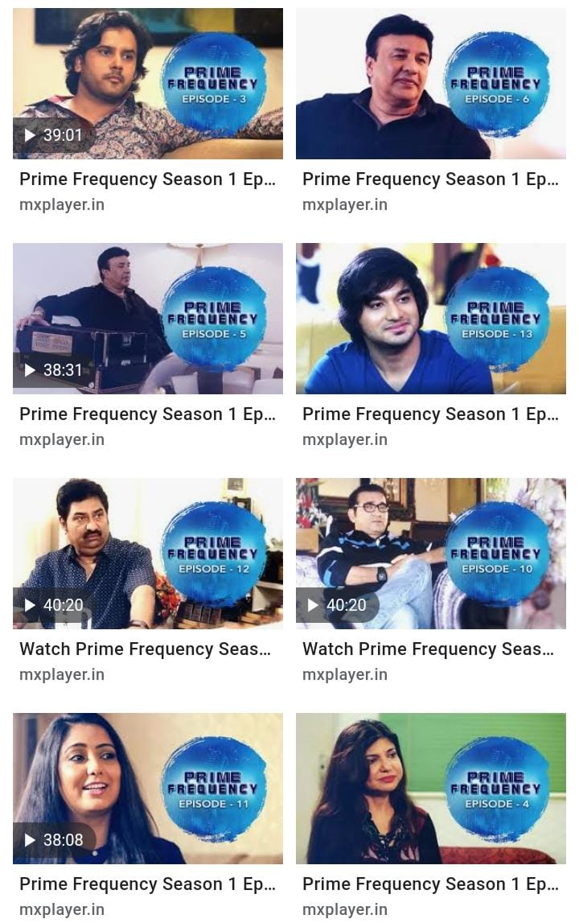
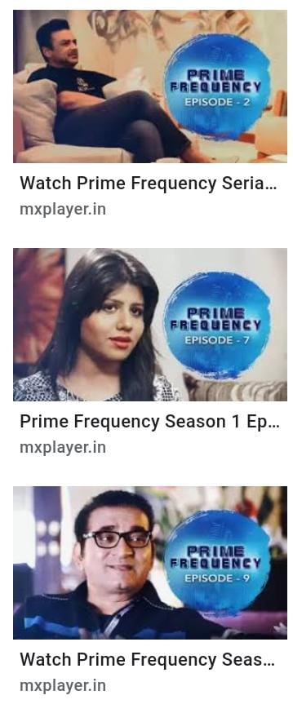
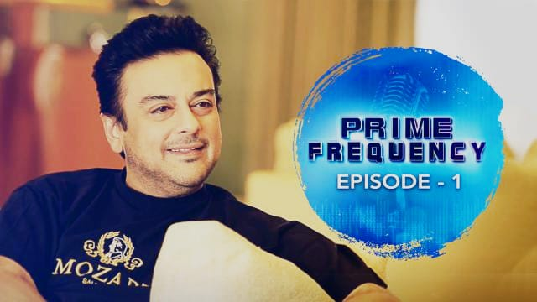
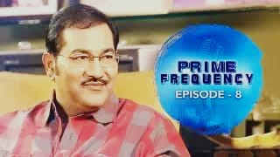
Our Projects
Prime frequency Promo 1 -
https://youtu.be/6GSWbwp9QME
Prime frequency Promo 2 –
https://youtu.be/5LdIVoclePw

Slide 41
Prime Frequency Show-video production
Links of the episodes..
https://www.mxplayer.in/show/watch-prime-frequency/season-1/episode-1-online-c2f7eac630ead580ef5b8e5f9be683bc
https://www.mxplayer.in/show/watch-prime-frequency/season-1/episode-2-online-9780d545657482d4924c8b5950a30486
https://www.mxplayer.in/show/watch-prime-frequency/season-1/episode-3-online-ac0709d6c7e3943e23e6204f02d64c5a
https://www.mxplayer.in/show/watch-prime-frequency/season-1/episode-4-online-c03d8d5631a87c8cac482dcf82af01c5
https://www.mxplayer.in/show/watch-prime-frequency/season-1/episode-5-online-3e2e7a54ab68f3aee622d3c4f01dd95f
https://www.mxplayer.in/show/watch-prime-frequency/season-1/episode-6-online-65a2f3f755f0d27412a62051ebc264be

Slide 42
Prime Frequency Show-video production
https://www.mxplayer.in/show/watch-prime-frequency/season-1/episode-7-online-b6d7877662fdd816b6dced4fa00bfc4d
https://www.mxplayer.in/show/watch-prime-frequency/season-1/episode-8-online-b256dd8e9d039c2355e1e23f2dfd2e56
https://www.mxplayer.in/show/watch-prime-frequency/season-1/episode-9-online-61a2891aadd5b4e531d946f7afe0f62a
https://www.mxplayer.in/show/watch-prime-frequency/season-1/episode-11-online-8ef397592f9b0597ee10475c70ff0ff8
https://www.mxplayer.in/show/watch-prime-frequency/season-1/episode-12-online-e2be311a99c07b35cc60ece15a96a3cf
https://www.mxplayer.in/show/watch-prime-frequency/season-1/episode-13-online-078c3491439306ab039c92d882ba35b4

Slide 43



Our Projects-video production
International commercial ad of ‘United kitchen and bedroom’
http://www.youtube.com/watch?v=BWkba66lyk4

Slide 44

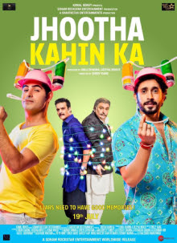
Our Projects-video production
Jabal Tariq (AV)
https://youtu.be/o6zTQ9iKaZ8
Line production for Jhootha Kahin ka song shot in Bangkok:
https://www.youtube.com/watch?v=YY96VQtc84M

Slide 45

Our Projects-video production
Skillsoft (AV)-2018
https://youtu.be/fSZNbAiUP5o
Skillsoft (AV)-2019
https://youtu.be/lFWqCuRksjo
https://youtu.be/wgYudAnBKXg

Slide 46

Our Projects- video productions
Co-Produced various episodes of Rishtey for Zee TV like Phislan, Uljhan, Ganpati Bappa Morya, Kinara, Naya Vivah etc. based on classic stories of Munshi Premchand and Sharatchand Chattopadhyay under my father’s production house for Zee TV.

Slide 47

Our Projects- video productions
Co-Produced a telefilm named ‘Haj-e- Akbar’ for ETV Urdu under my father’s production house.

Slide 48





Our Esteemed Clientele

Slide 49
Contact Us
Visit us at www.niticreations.com
We would be glad to meet you to discuss your requirements in detail.
Proprietor: Niti Mathur
Mobile: 9820239024
E-mail: niticreations.nm@gmail.com
Creative & Administration: Jeet Dutta
Mobile no.: 7208732192

Slide 50
Looking forward eagerly to be associated with you.
            THANK YOU

